Slide 1
Smart Company CareerMatch
AI-Powered Job Search, Resume Matching & Career Preparation Assistant
A unified Streamlit application that connects job discovery, resume analysis, skill matching and role-specific interview preparation.
JOB SEARCH
RESUME ANALYSIS
JOB MATCHING
INTERVIEW PREP
Presented by: Shaik Mahammad Abdul Zaib
SMD Sajid Mujahid
P.Sathvik Rao
S Dheeraj Reddy

Slide 2
Problem Statement
Challenges faced during job discovery and interview preparation
Scattered job discovery
Resume–job mismatch
Generic preparation
Opportunities are spread across company career pages and public ATS platforms. Users often repeat the same search.
Candidates need a quick way to compare their skills with a specific role and identify missing skills.
Interview preparation is often disconnected from the selected role. Focused, role-aware questions are more useful.
Project objective: connect discovery → analysis → matching → preparation in one workflow.
CAREERMATCH • 02

Slide 3
Proposed Solution
A single application for the complete career-preparation journey
Search
Analyse
Match
Prepare
01
02
03
04
Natural-language job/company search
Extract skills from a resume
Compare candidate and job skills
Create preparation and interview questions
Core value: reduce the gap between finding a job and knowing how to prepare for it.
Fast focused search • optional broader live-source search • resume parsing • skill matching • skill-gap identification • personalised preparation • 100 interview questions
CAREERMATCH • 03

Slide 4
System Architecture
Modular components and information flow
Streamlit UI
Job Sources
NLP / Matching
Preparation
User interaction
ATS + official sources
Skills + similarity
Plans + questions
Resume Parser
SQLite
RAG / Context
PDF / DOCX / TXT
Local persistence
Company-aware context
Python • Streamlit • SQLite • NLP/skill matching • public job-source connectors
Separation of modules keeps retrieval, parsing, matching and preparation logic easier to test and extend.
CAREERMATCH • 04

Slide 5
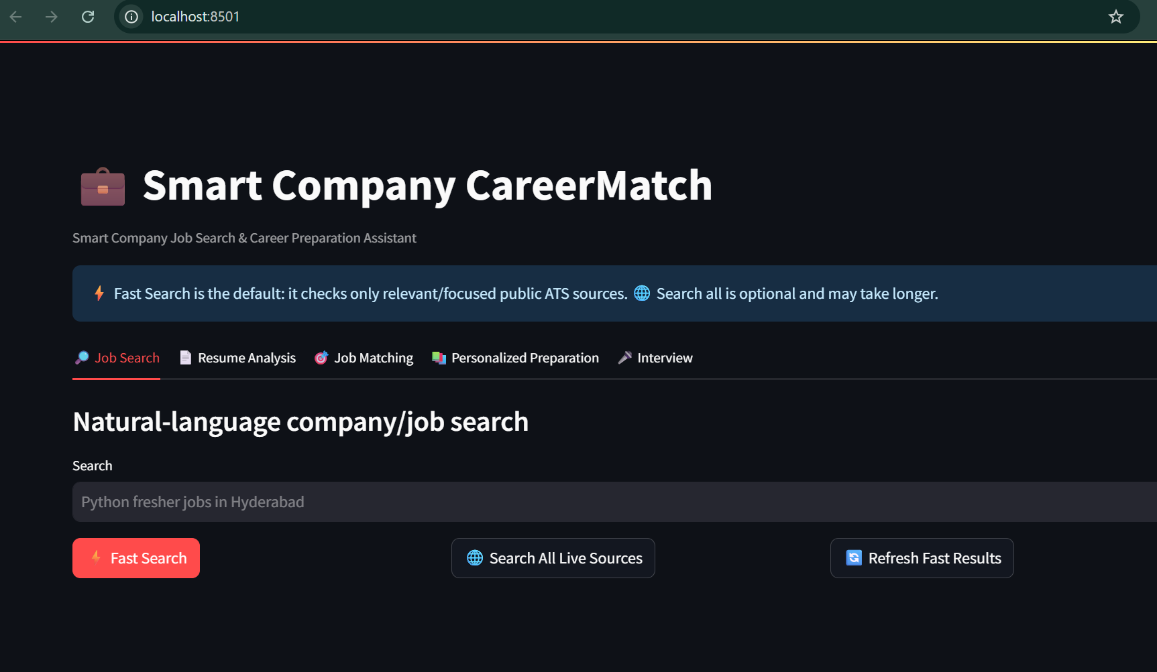
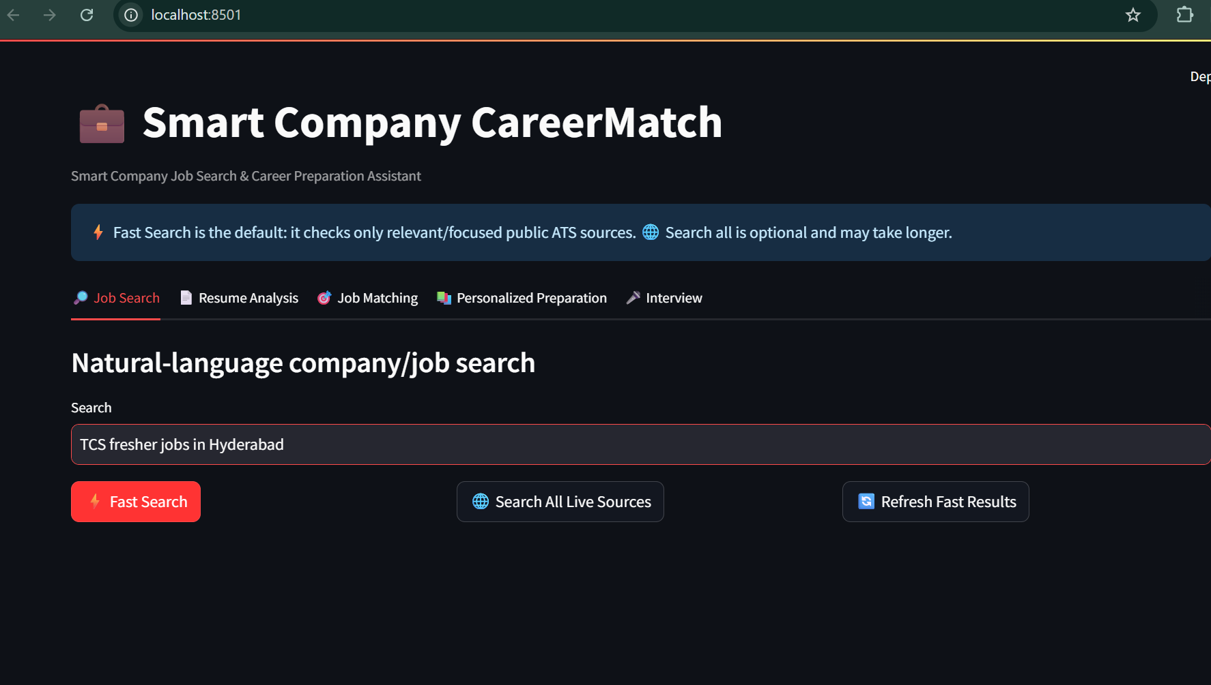
Feature 01 — Natural-Language Job Search
Users can search with everyday phrases such as “TCS fresher jobs in Hyderabad”.
Application home and search interface
Example: TCS fresher job search
The interface supports fast focused search and an optional broader live-source search, helping users discover relevant roles with less manual effort.
CAREERMATCH • 05

Slide 6
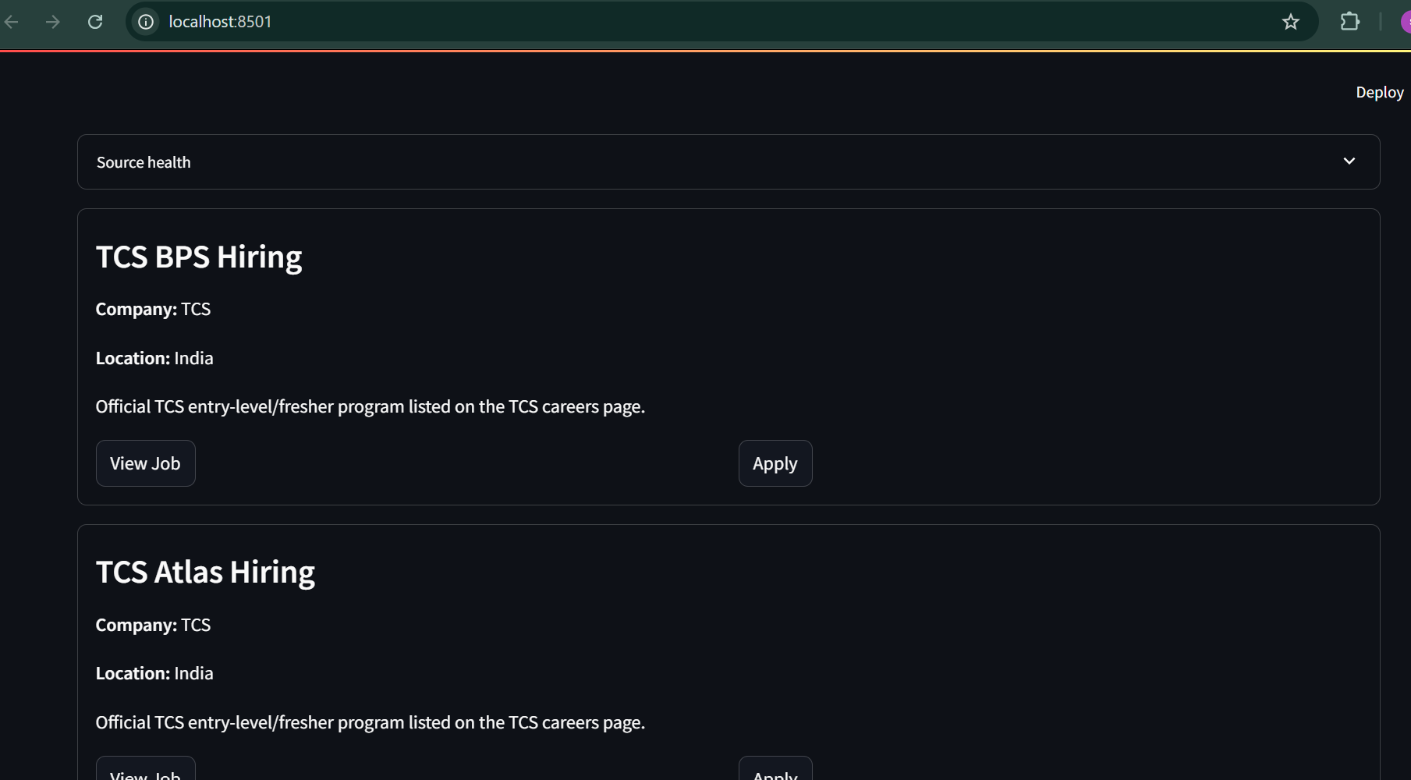
Job Discovery — Source Results
Structured result cards make job opportunities easy to scan and act on.
Example TCS results with company, location, role context and actions
View Job and Apply actions connect the discovery experience to the relevant opportunity.
CAREERMATCH • 06

Slide 7
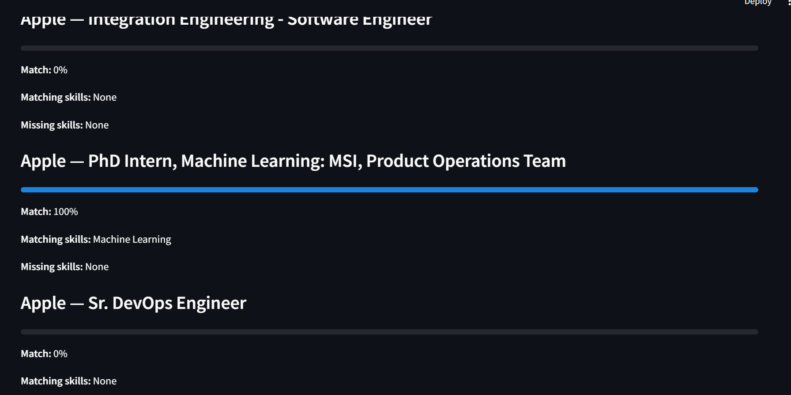
Feature 02 — Resume-to-Job Skill Matching
The matching module compares extracted candidate skills with the selected role.
Match percentage
A simple percentage communicates the degree of skill alignment.
Matching skills
Shows skills found in both the candidate profile and the job.
Missing skills
Highlights gaps that can guide learning and preparation.
Example matching results
CAREERMATCH • 07

Slide 8
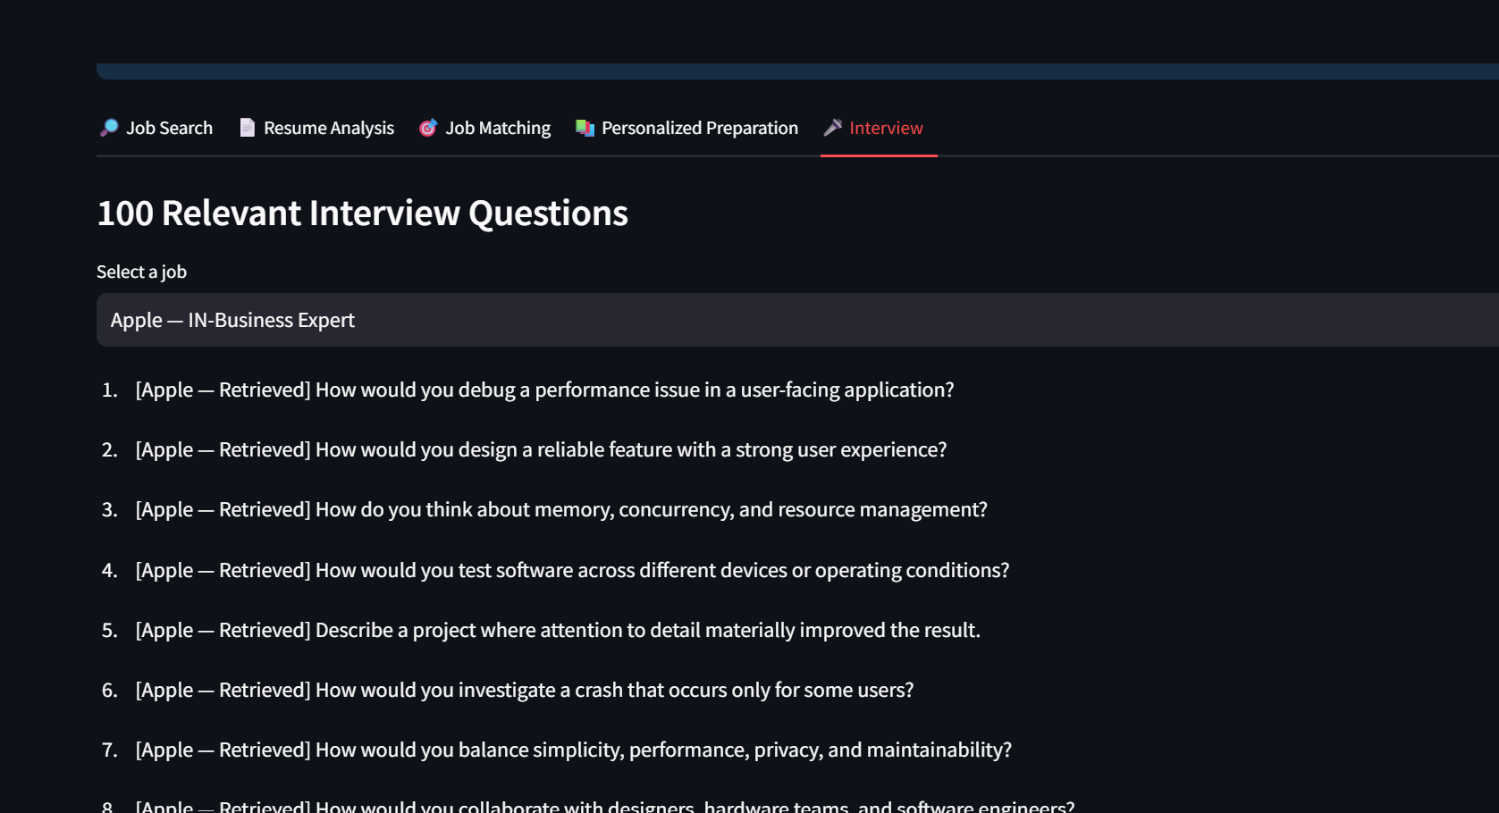
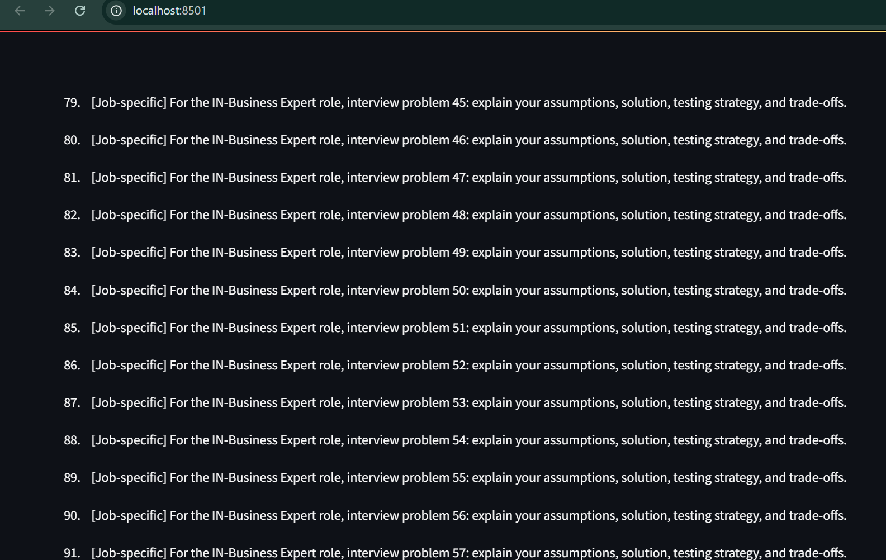
Feature 03 — Role-Specific Interview Preparation
Generates a large, role-aware set of questions for the selected job.
Interview tab — first question set
Interview tab — job-specific question set
Questions include retrieved role-oriented prompts and job-specific interview problems.
CAREERMATCH • 08

Slide 9
Technology Stack
Technologies used to build the current prototype
Python
Streamlit
Core application and business logic
Interactive web interface
SQLite
NLP / Skill Matching
Local database and persistence
Resume and job comparison
PDF / DOCX / TXT
Public ATS Sources
Resume ingestion
Greenhouse, Lever, Ashby and official sources
Modular Python files • automated tests • environment configuration via .env
CAREERMATCH • 09

Slide 10
End-to-End User Workflow
From discovering an opportunity to preparing for its interview
1
Enter a search
Example: Python fresher jobs in Hyderabad
2
Review jobs
Inspect relevant company and role results
3
Upload resume
Extract candidate skills
4
Select a job
Calculate match and skill gaps
5
Prepare
Use targeted preparation and 100 interview questions
CAREERMATCH • 10

Slide 11
Project Outcomes & Future Enhancements
Current capabilities and possible next steps
Current capabilities
Future enhancements
• Natural-language job/company search
• Public-source / ATS retrieval
• Resume parsing and skill extraction
• Resume-to-job matching
• Skill-gap identification
• Personalised preparation
• 100 relevant interview questions
• More official career integrations
• Stronger semantic matching
• Duplicate detection and ranking controls
• Richer resume feedback
• Authentication and cloud deployment
• Job alerts and saved searches
• Interview answer evaluation
Vision: evolve from a job-search utility into a complete, explainable career-preparation platform.
CAREERMATCH • 11

Slide 12
Thank You
Smart Company CareerMatch
A practical Python + Streamlit project connecting job discovery, resume intelligence, skill matching and interview preparation.
Questions & Discussion
Shaik Mahammad Abdul Zaib
CAREERMATCH • 12

